Slide 1


Deep Learning for Natural Language Processing DLNLP 2: The Perceptron
Mihai Surdeanu and Marco A. Valenzuela-Escárcega

Slide 2
Resources
Text and code available here: http://clulab.github.io/gentlenlp/

Slide 3
Computer Science
Artificial Intelligence
Machine
Learning
Deep
Learning
Natural
Language
Processing

Slide 4
Why machine learning?

Slide 5
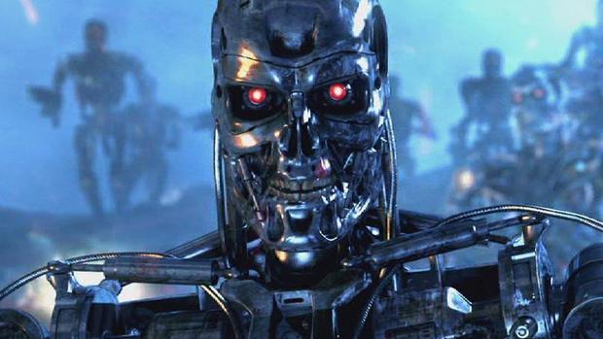
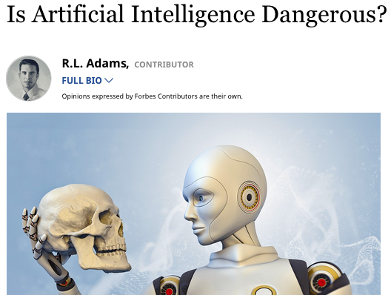
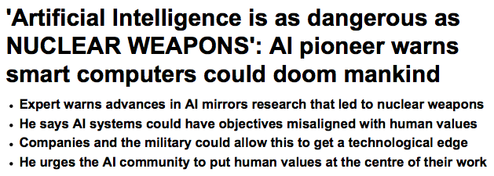

Slide 6
Those things probably won’t happen.
But you are already using many applications of machine learning today.

Slide 7


You wake up listening to your music
Examples from The Master Algorithm, by Pedro Domingos

Slide 8
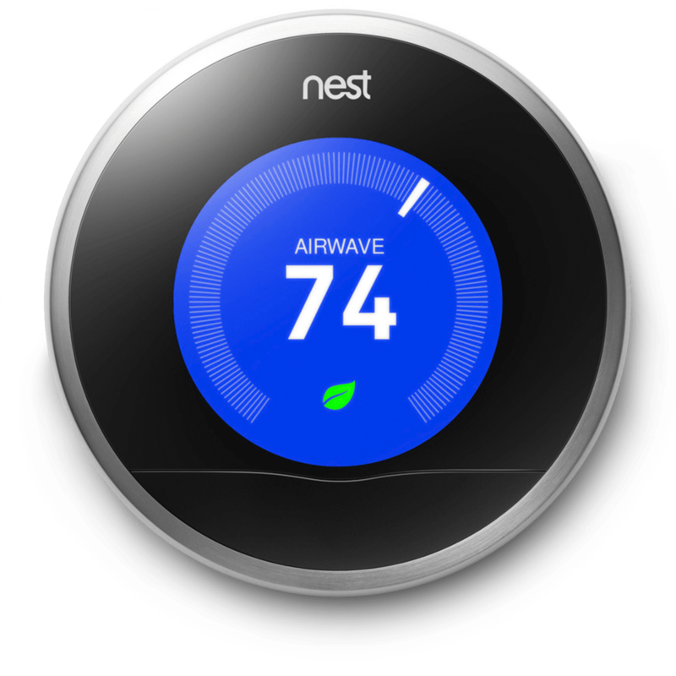
The temperature is adjusted for you
Examples from The Master Algorithm, by Pedro Domingos

Slide 9
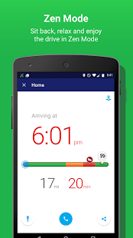
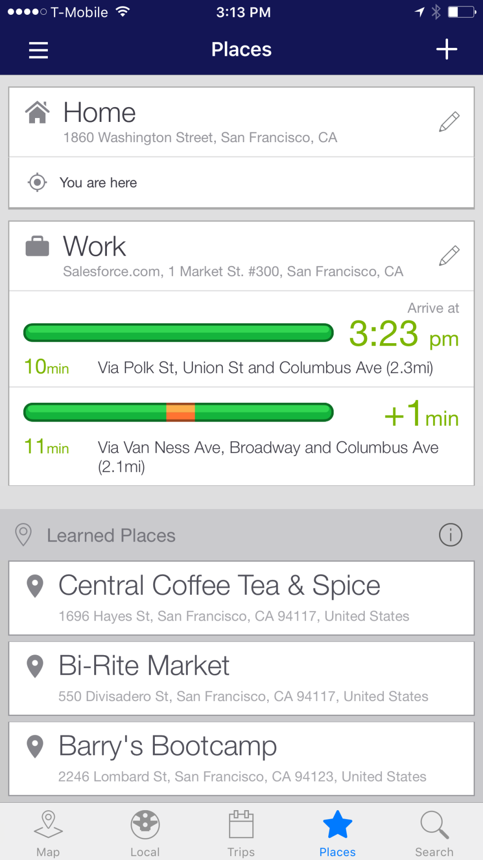

An algorithm predicts traffic when you drive to work
Examples from The Master Algorithm, by Pedro Domingos

Slide 10
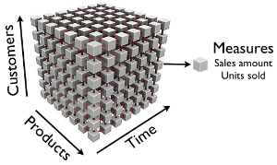

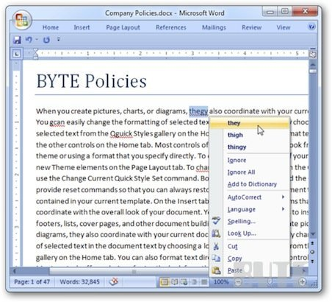

At work…
Examples from The Master Algorithm, by Pedro Domingos

Slide 11
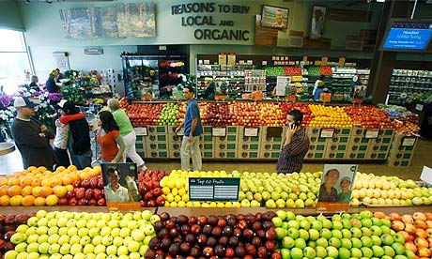

After work, at the supermarket…
Examples from The Master Algorithm, by Pedro Domingos

Slide 12


Back at home, you walk your dog to get your mail
Examples from The Master Algorithm, by Pedro Domingos
Notes:
ML monitors video feeds to keep you safe
Letters routed by an algorithm that reads hand-written addresses

Slide 13
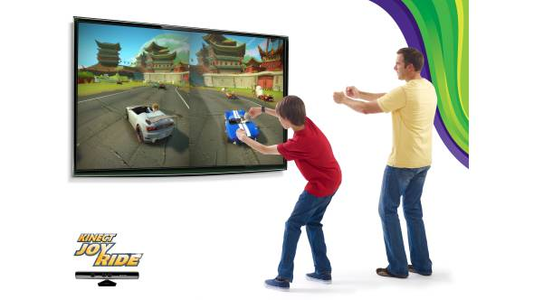
After dinner you play with your kids
Examples from The Master Algorithm, by Pedro Domingos
Notes:
Xbox Kinnect tracks movement

Slide 14

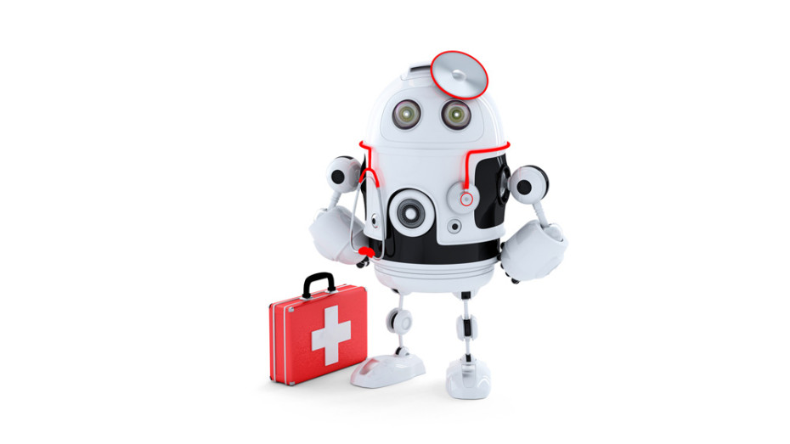
You take a pill before calling it a day
Examples from The Master Algorithm, by Pedro Domingos
Notes:
take a pill at night: diagnosed with help of ML, drug designed/tested with ML <=== Reach

Slide 16
Why natural language processing?

Slide 17
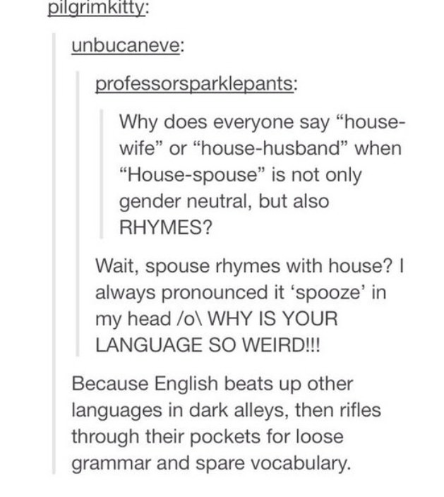
Language is beautiful and hard…

Slide 18
“Beating up” other languages
Why do we eat “pork” and “beef” but we raise “pigs” and “cows”?
What is the percentage of cognates with French in English?

Slide 19
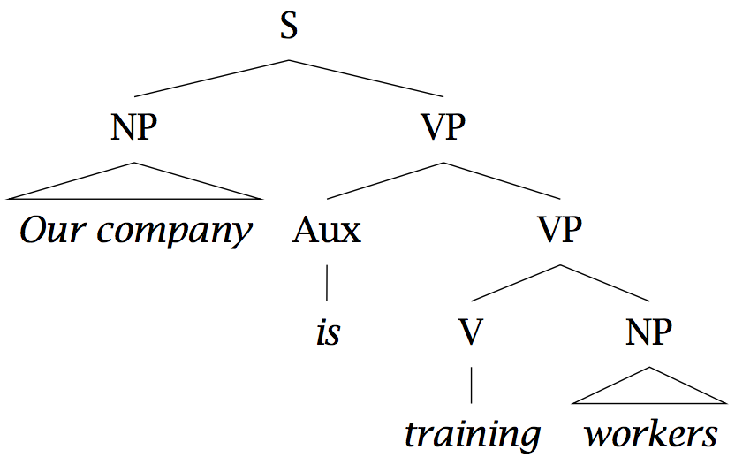
Who did what to whom?
“Our company is training workers.”
Correct: “is training” as a verb group

Slide 20
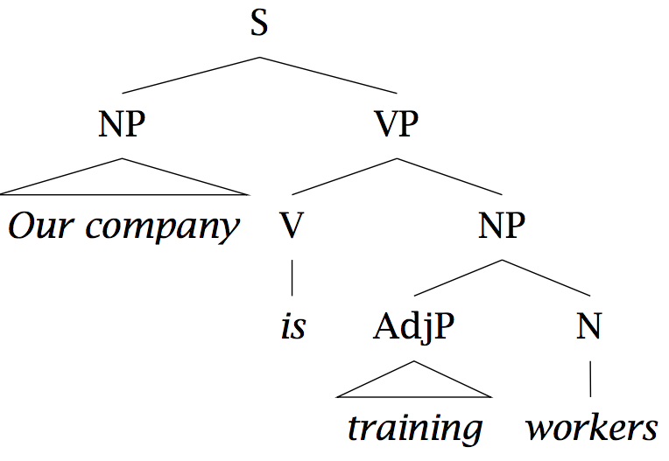
Who did what to whom?
Incorrect: “training” modifies “workers, as in: “Those are training wheels.”

Slide 21
Ambiguity and selectional preferences
I swallowed a bug while running.
What selectional preferences would you add for the verb “swallow”?
I swallowed his story, hook, line, and sinker.
The supernova swallowed the planet.

Slide 22
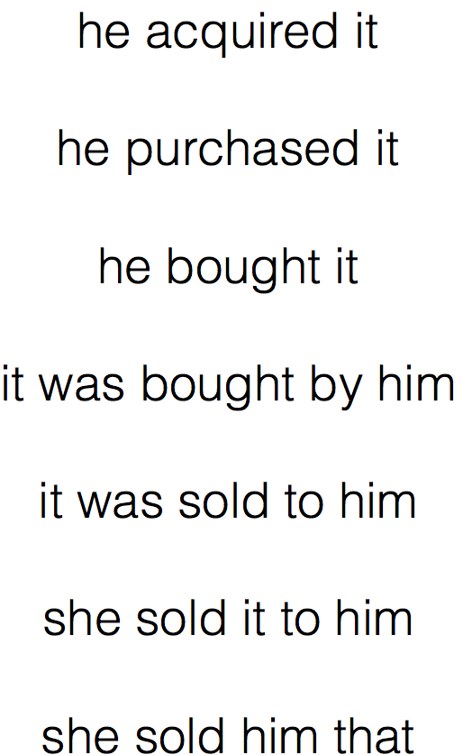
Variability
Slide by Yoav Goldberg

Slide 23

Discourse/Ellipsis/Multi-modality

Slide 24
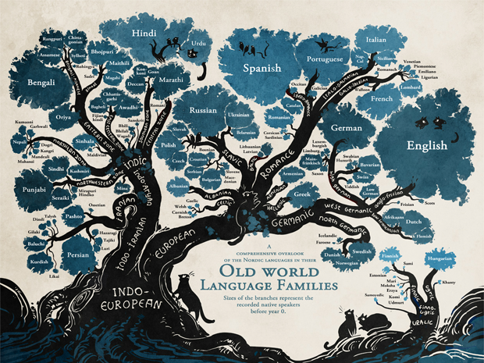
There are about 7K languages in the world

Slide 25
language understanding enables important applications

Slide 26
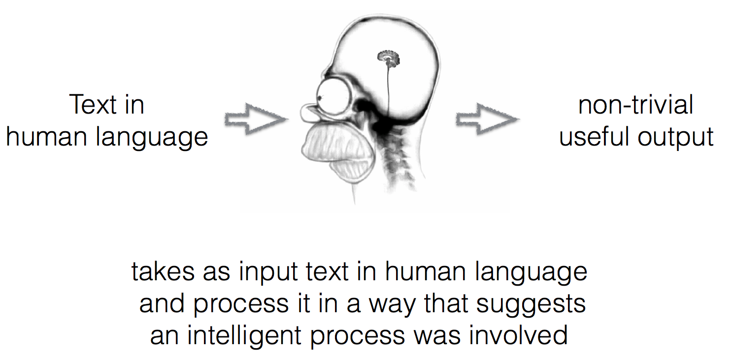
Natural Language Processing (NLP) in a nutshell
Slide by Yoav Goldberg

Slide 27
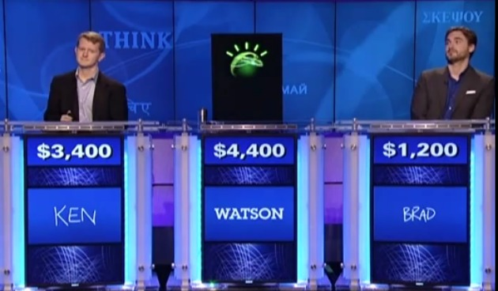
NLP Applications Question Answering

Slide 28
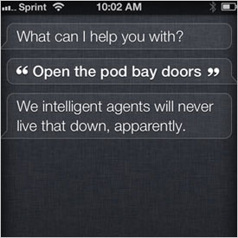
NLP Applications Question Answering

Slide 29
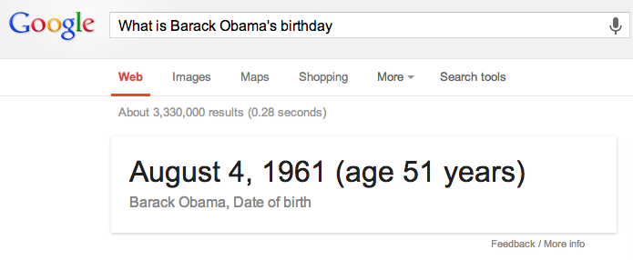
NLP Applications Question Answering

Slide 30
NLP Applications Question Answering
When athletes begin to exercise, their heart rates and respiration rates increase. At what level of organization does the human body coordinate these functions?
A: at the tissue level
B: at the organ level
C: at the system level
D: at the cellular level
Unsolved problem!
Needs inference
Very little training data

Slide 31
Machine reading/Information extraction
Human domain experts are around here

Slide 32
Machine reading/Information extraction

Slide 33
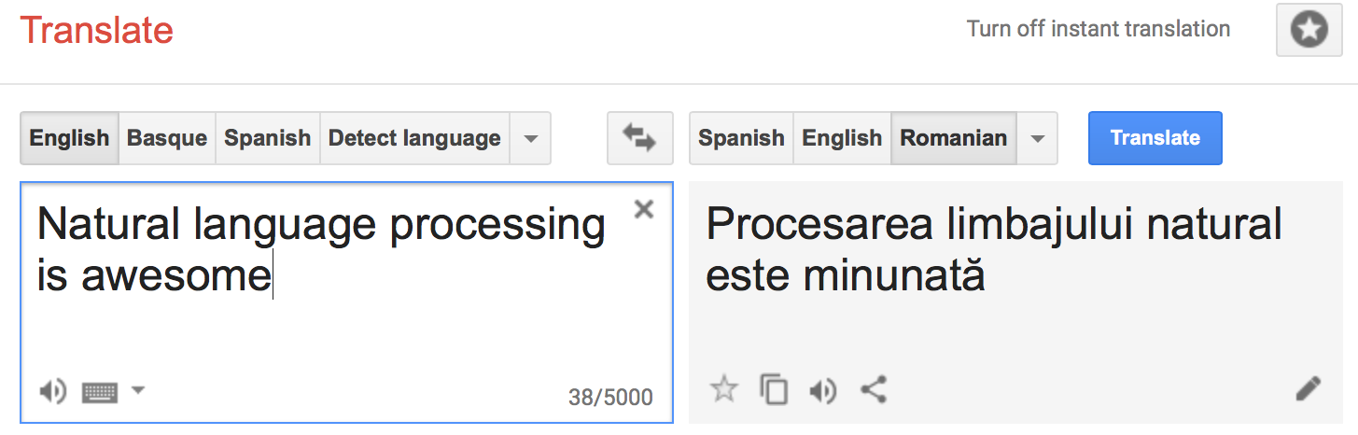
Machine translation

Slide 34
And many others…
Exercise: can you suggest a few other NLP applications?

Slide 35
Most NLP applications are built using deep learning
Deep learning = subset of machine learning methods that use artificial neural networks (ANN)
Simplest ANN has 1 neuron = perceptron (we will discuss this today)

Slide 36
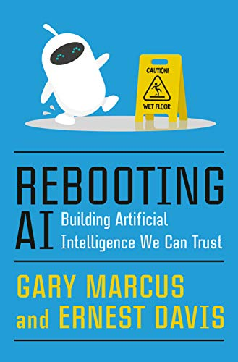
Deep learning is far from perfect
Deep learning is opaque, brittle, and has no commonsense

Slide 37
Why another deep learning course?

Slide 38
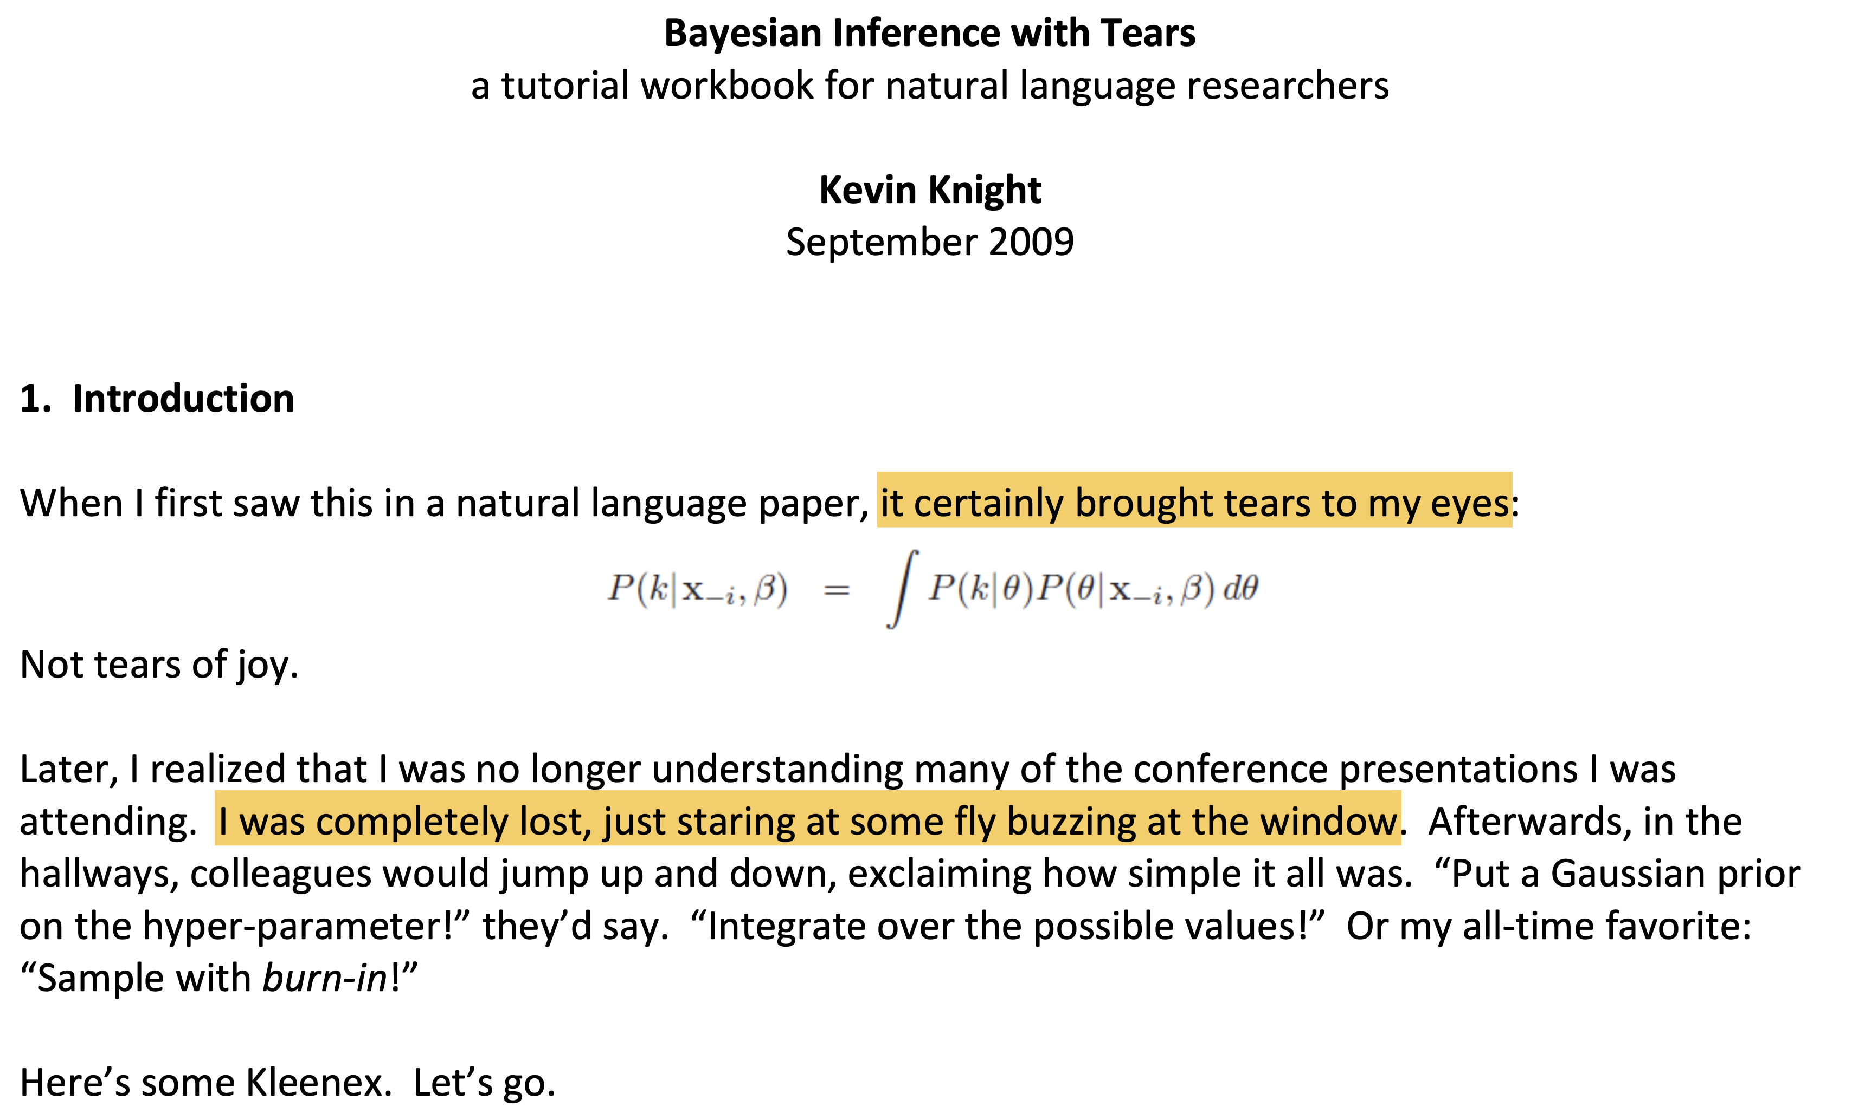

Slide 39
The Perceptron
Chapter 2

Slide 40

Let’s read a book

Slide 41


Slide 42
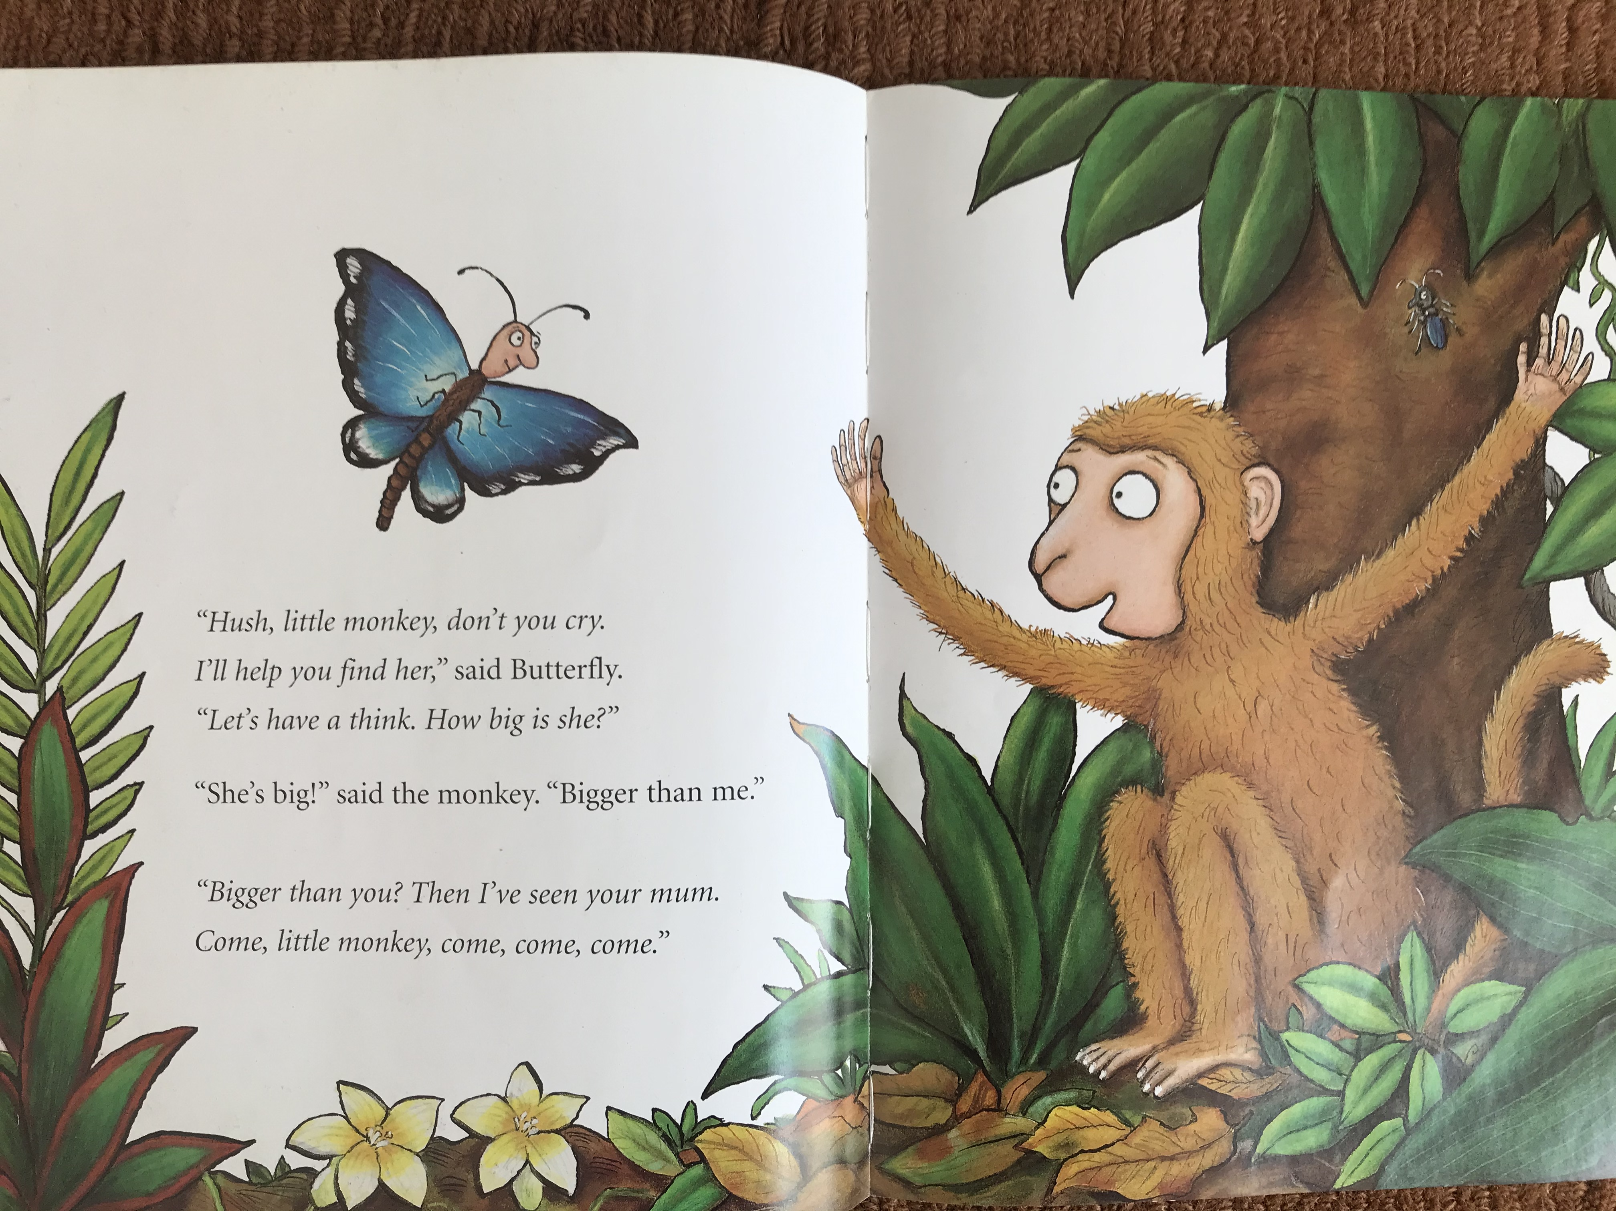

Slide 43


Slide 44
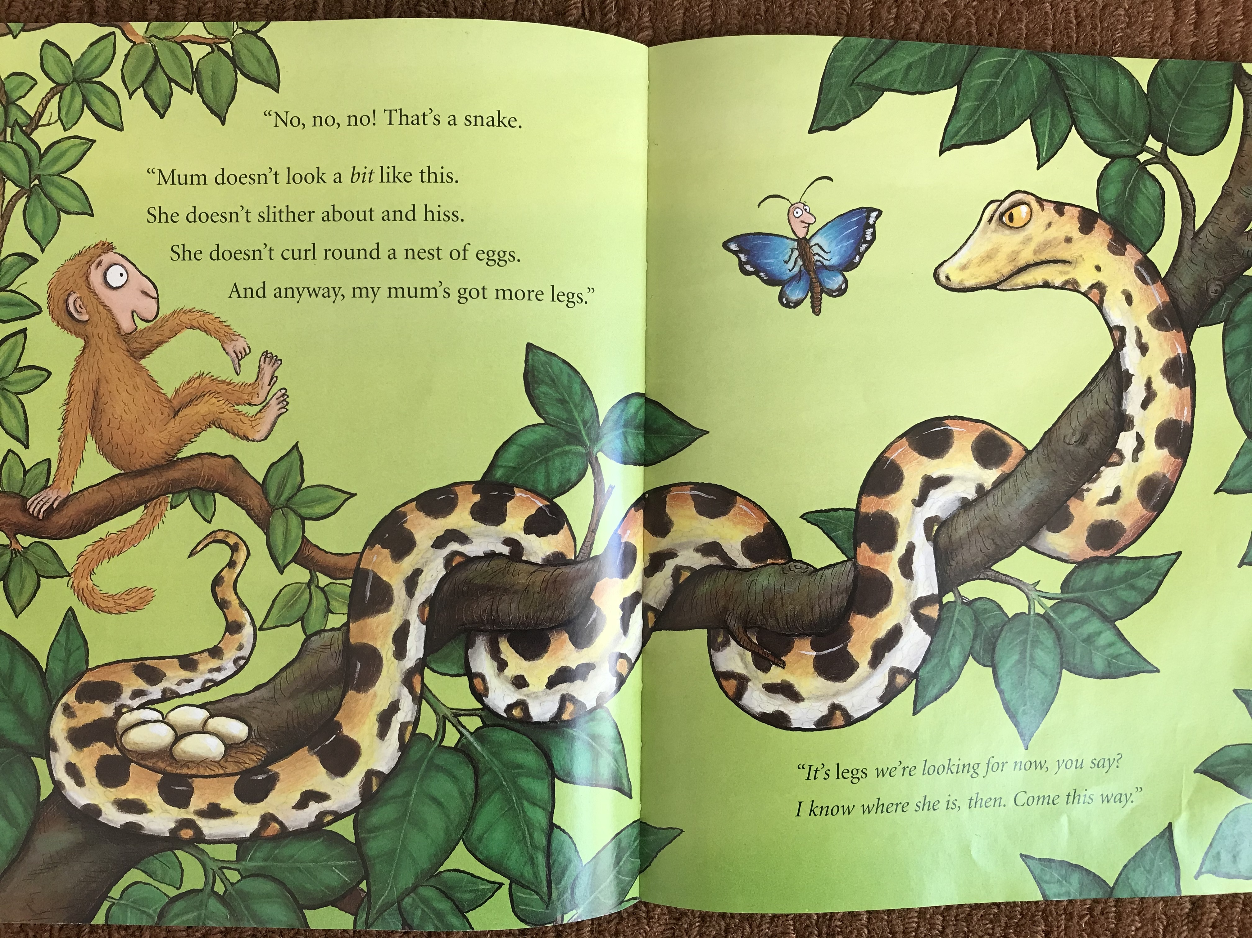

Slide 45
…

Slide 46


Slide 47
What have we learned from this book?
Objects are described by their properties or features
E.g.: isBig, hasTail, hasColor, numberOfLimbs…
Features have values
Boolean: true/false
Discrete: brown, white, etc.
Numerical: 4 for numberOfLimbs

Slide 48
What have we learned from this book?
Objects are assigned a discrete label, e.g., isMyMom, isNotMyMom
A learning algorithm (the butterfly in the story) or classifier will learn how to assign labels to new objects
Hint: features are important if they lead to the correct decision; less important otherwise
Learning algorithms produce incorrect classifications when not exposed to sufficient data. This situation is called overfitting.

Slide 49
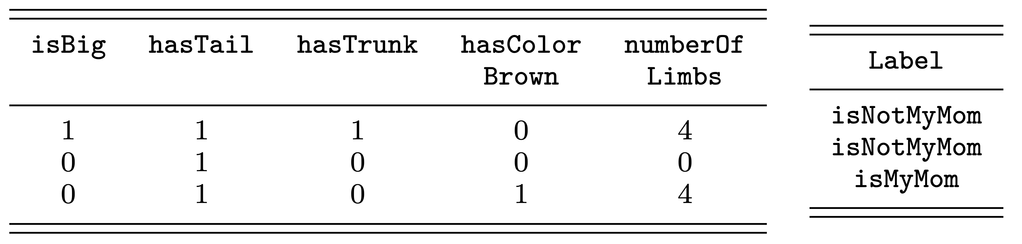
Let’s formalize what we know so far
Feature matrix X
One example per row
One feature per column
Label vector y
Supervised classification!

Slide 50
Use case: text classification
Text classification = learning algorithms that assign labels to text
Exercise: what applications of text classification do you know?

Slide 51
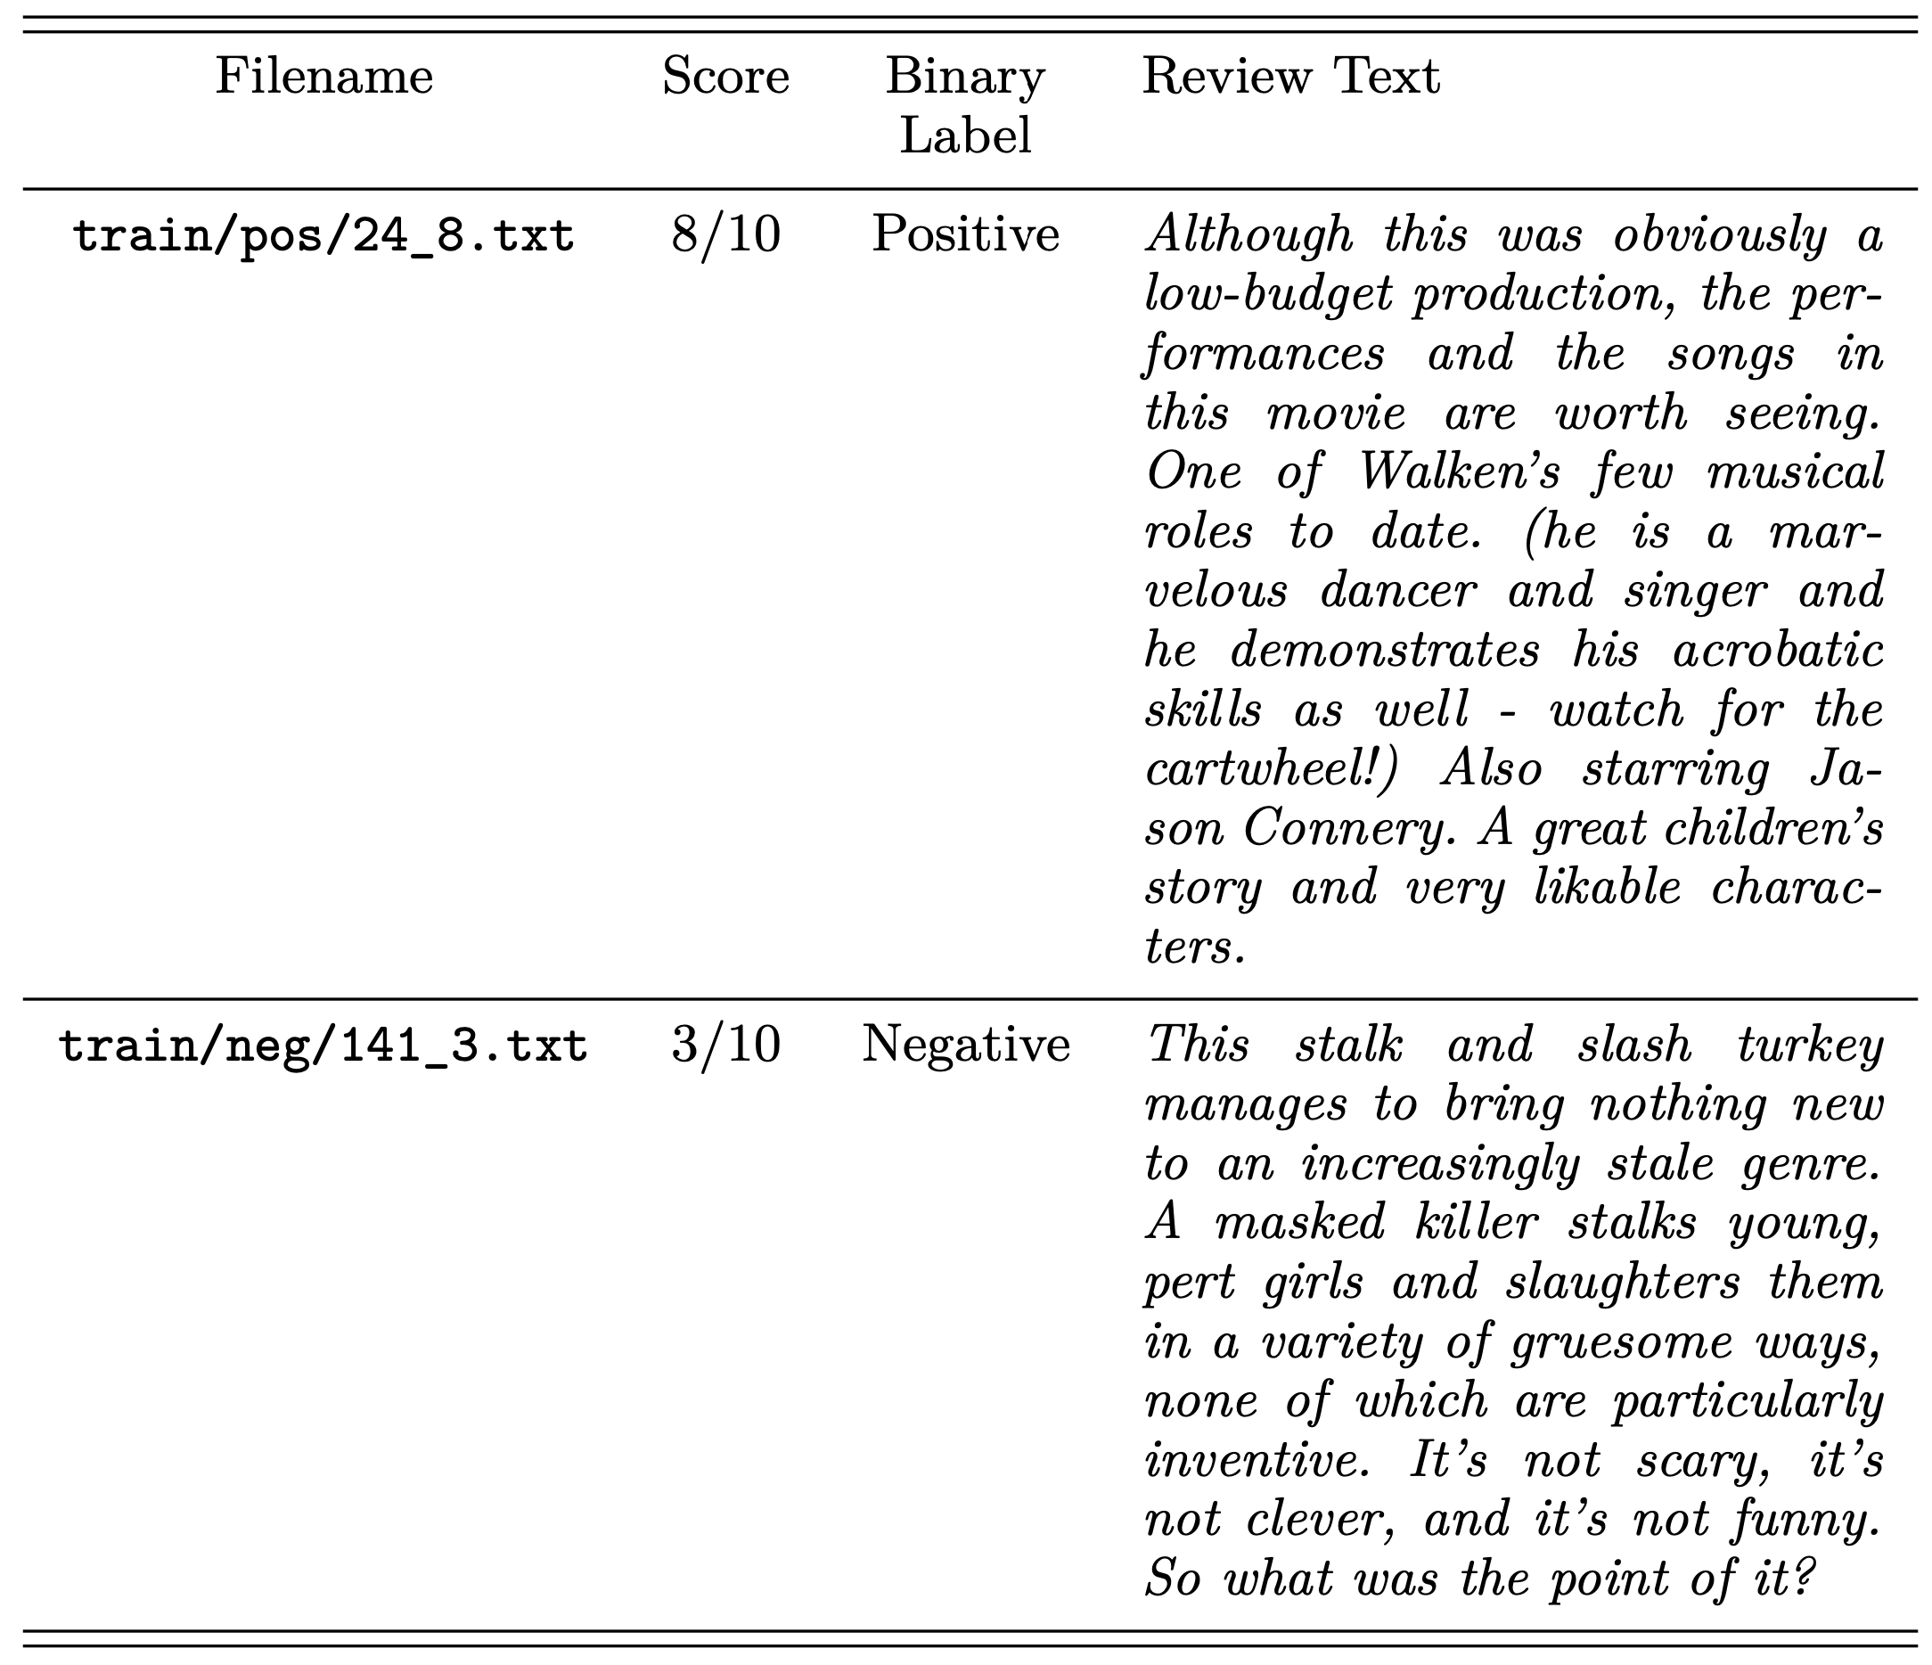
IMDB movie reviews dataset

Slide 52
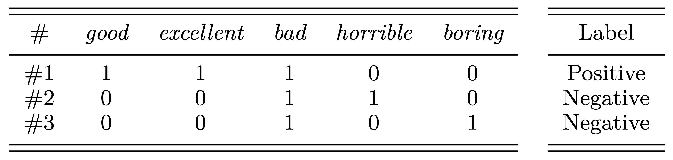
More formally…
Feature matrix X
Individual feature: how many times a given word appears in a review
Label vector y
Exercise: how many columns does X have?

Slide 53
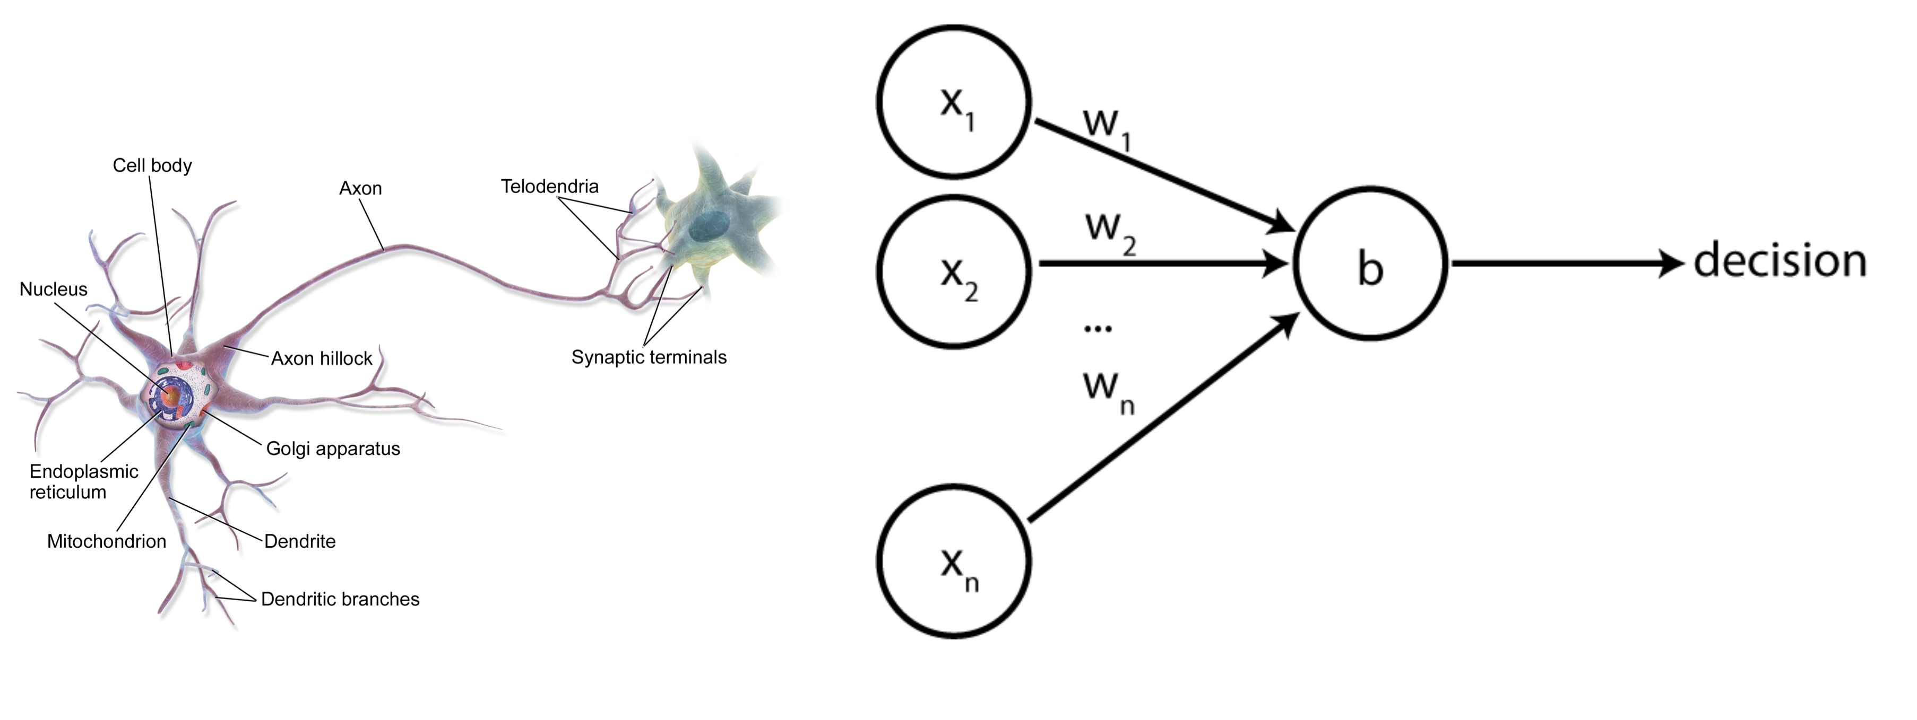
The perceptron

Slide 54
The perceptron

Slide 55
The perceptron
One row from the feature matrix X

Slide 56
The perceptron
Weights that indicate how important each feature is
This is what is learned!

Slide 57
The perceptron
A scalar value called a bias term. We will explain this later.

Slide 58
The perceptron
A scalar value that is the classifier’s output. If >= 0 we assign one label; otherwise we assign the other label

Slide 59
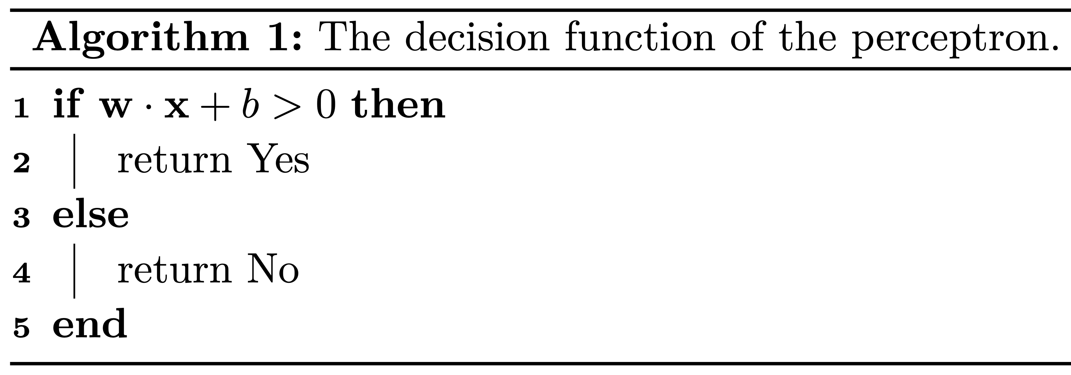
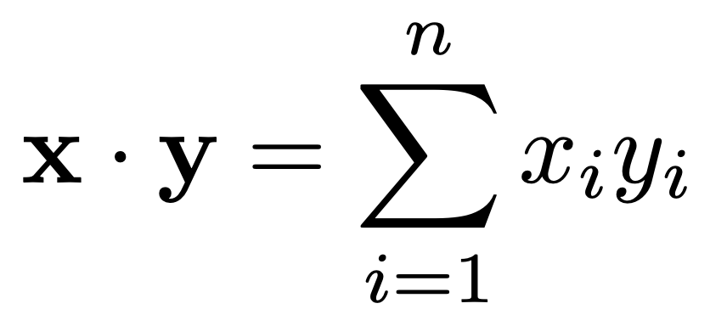
Perceptron decision function
Dot product of two vectors

Slide 60
Intuition
If the Yes class is isMyMom then
We want the weight associated with hasColorBrown to be positive, and
The weight for hasTrunk to be negative
Similarly, for review classification (Yes == Positive) we want positive words to have positive weights, and negative words to have negative weights

Slide 61
How do we learn the perceptron weights to achieve this?

Slide 62
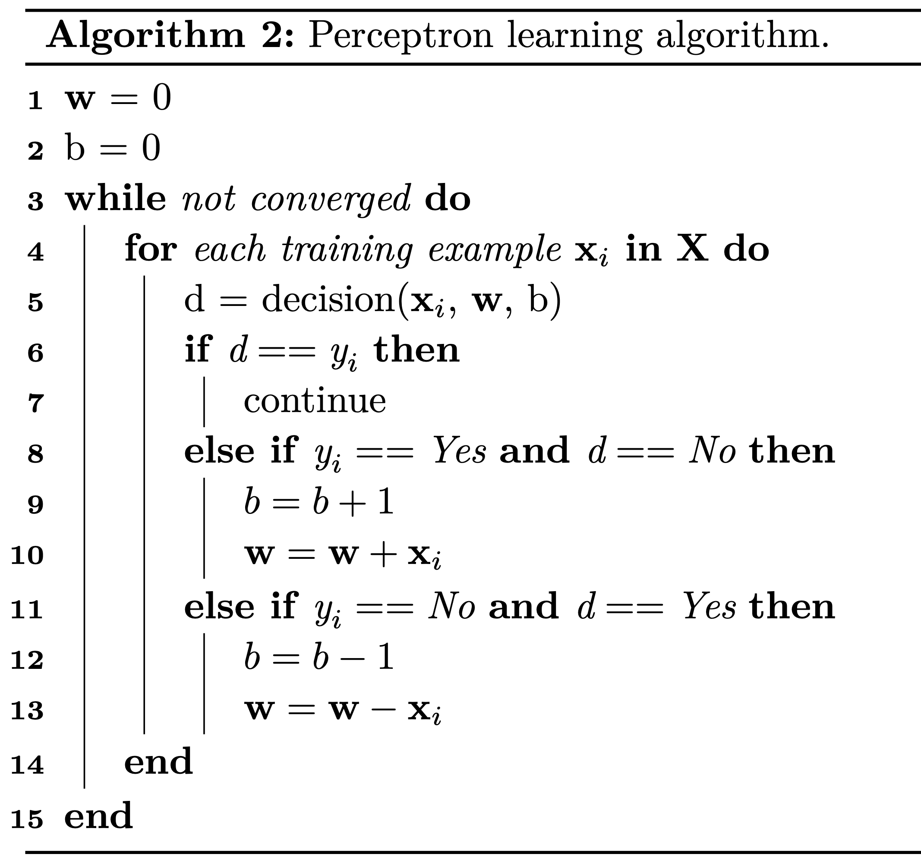
Training the perceptron

Slide 63
Training the perceptron
Initialize weights and bias with 0s

Slide 64
Training the perceptron
Cycle through the training data until the weights no longer change

Slide 65
Training the perceptron
Predict label using the current weights

Slide 66
Training the perceptron
The label is correct. Move on

Slide 67
Training the perceptron
We made a mistake on the positive (Yes) label
Add x_{i} to the weights

Slide 68
Training the perceptron
We made a mistake on the negative (No) label
Subtract x_{i} from the weights

Slide 69
Exercise
What are the perceptron’s weights after one pass over this training data?
Initially:
w = (0, 0, 0, 0, 0)
b = 0

Slide 70
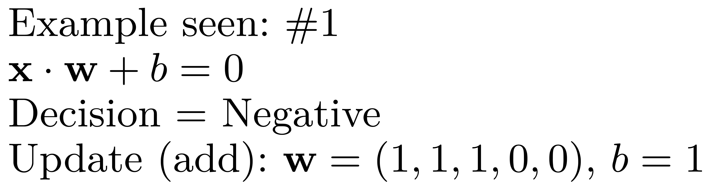
Exercise

Slide 71
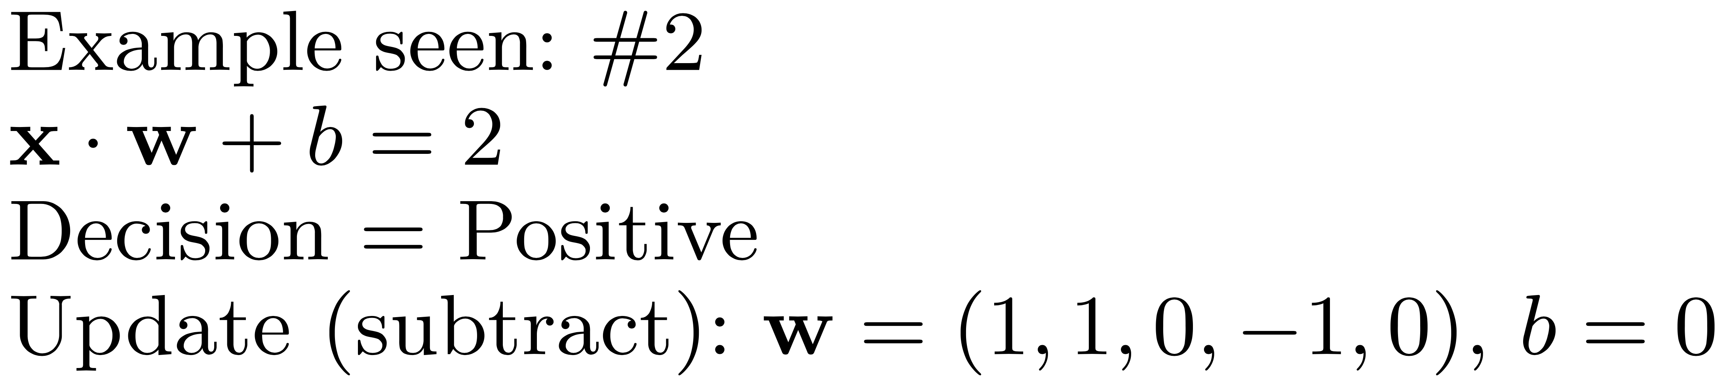
Exercise

Slide 72
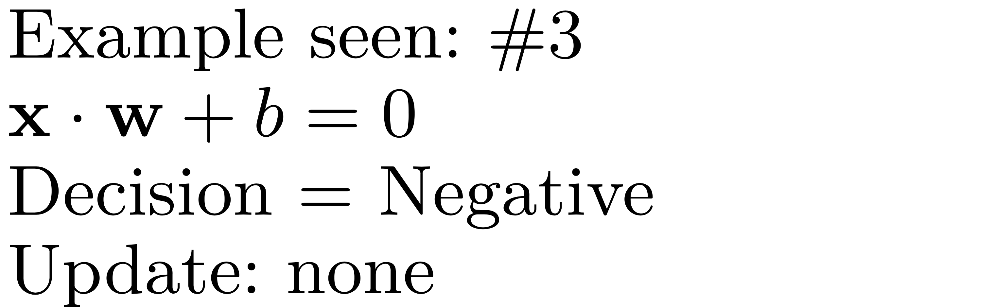
Exercise

Slide 73
But why do we need that bias term?
In some cases the perceptron cannot learn without a bias term.
Let’s see an example

Slide 74
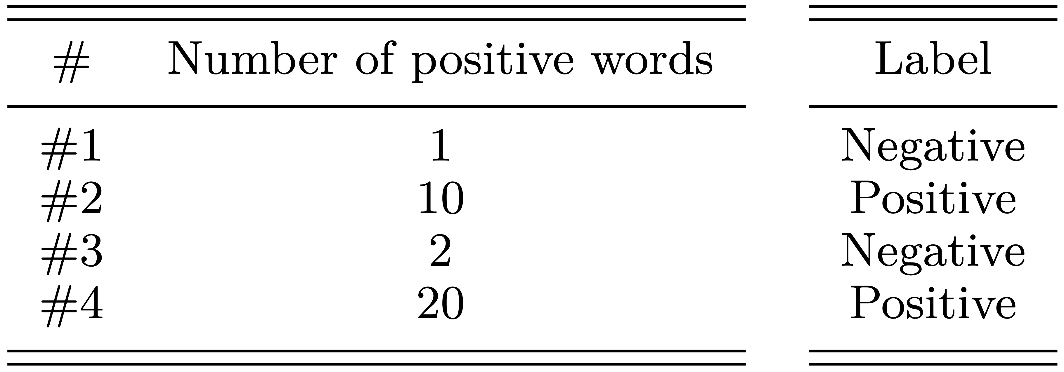
But why do we need that bias term?
After 4 passes (epochs) over this training data, the learned parameters are:
w = (2)
b = -4
Decision: 2x – 4 > 0
That is, a review must have at least three positive words to receive a positive label

Slide 75
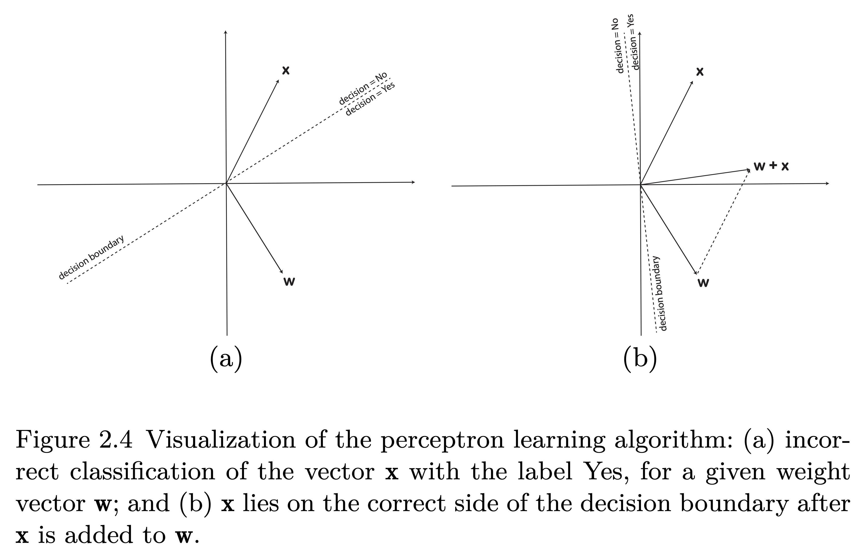
Visualizing the perceptron learning
In general, this line is a hyper plane. Classifiers whose decision boundary is a hyper plane are linear classifiers.

Slide 76
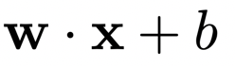
Drawbacks of the perceptron
It can only learn linear functions.
We hardcoded:
It has no “smooth” updates during training.
This leads to instability during training and poorer performance during evaluation.

Slide 77
Take away
Text classification
The perceptron decision function
The perceptron learning algorithm
Visualizing the perceptron learning
Drawbacks of the perceptron

Slide 78
Not covered but available in the book
Voting perceptron
Average perceptron
Evaluation measures for text classification

